Slide 1


Titolo presentazione sottotitolo
Estimation and Learning in Aerospace
Milano, XX mese 20XX
Alessandro Boldrini
Lorenzo Miele
Gianluca Napoletano

Slide 2
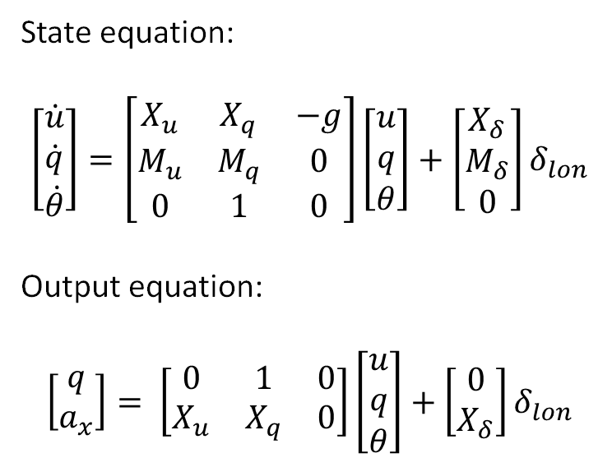
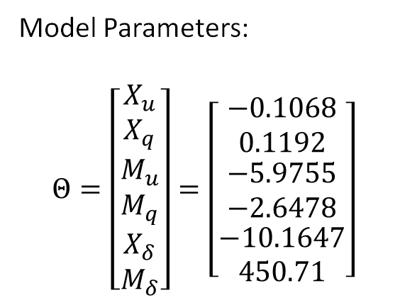
Task 1 – Linearized model
State equation:
$$\left[\begin{matrix}\dot{u} \\ \dot{q} \\ \dot{θ}\end{matrix}\right]=\left[\begin{matrix}X_{u} & X_{q} & −g \\ M_{u} & M_{q} & 0 \\ 0 & 1 & 0\end{matrix}\right]\left[\begin{matrix}u \\ q \\ θ\end{matrix}\right]+\left[\begin{matrix}X_{δ} \\ M_{δ} \\ 0\end{matrix}\right]δ_{lon}$$
Output equation:
$$\left[\begin{matrix}q \\ a_{x}\end{matrix}\right]= \left[\begin{matrix}0 & 1 & 0 \\ X_{u} & X_{q} & 0\end{matrix}\right]\left[\begin{matrix}u \\ q \\ θ\end{matrix}\right]+\left[\begin{matrix}0 \\ X_{δ}\end{matrix}\right]δ_{lon}$$
Model Parameters:
$$Θ=\left[\begin{matrix}X_{u} \\ X_{q} \\ \begin{matrix}M_{u} \\ M_{q} \\ \begin{matrix}X_{δ} \\ M_{δ}\end{matrix}\end{matrix}\end{matrix}\right]=\left[\begin{matrix}−0.1068 \\ 0.1192 \\ \begin{matrix}−5.9755 \\ −2.6478 \\ \begin{matrix}−10.1647 \\ 450.71\end{matrix}\end{matrix}\end{matrix}\right]$$

Slide 3
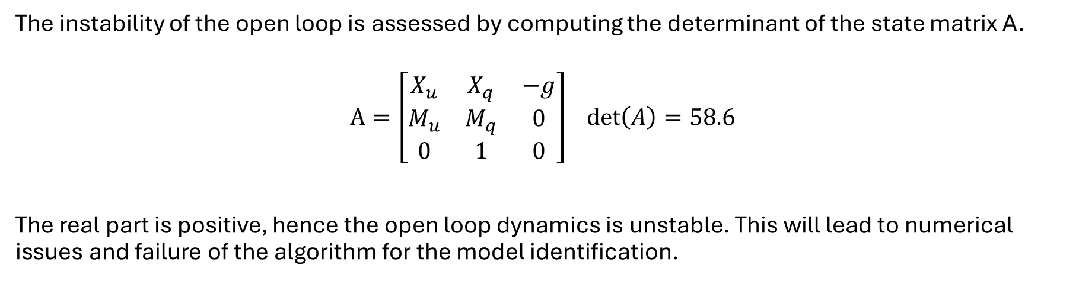
Task 1 - Instability of the open loop dynamics
The instability of the open loop is assessed by computing the determinant of the state matrix A.
$$A=\left[\begin{matrix}X_{u} & X_{q} & −g \\ M_{u} & M_{q} & 0 \\ 0 & 1 & 0\end{matrix}\right] det\left(A\right)=58.6$$
The real part is positive, hence the open loop dynamics is unstable. This will lead to numerical issues and failure of the algorithm for the model identification.
Frequency domain

Slide 4
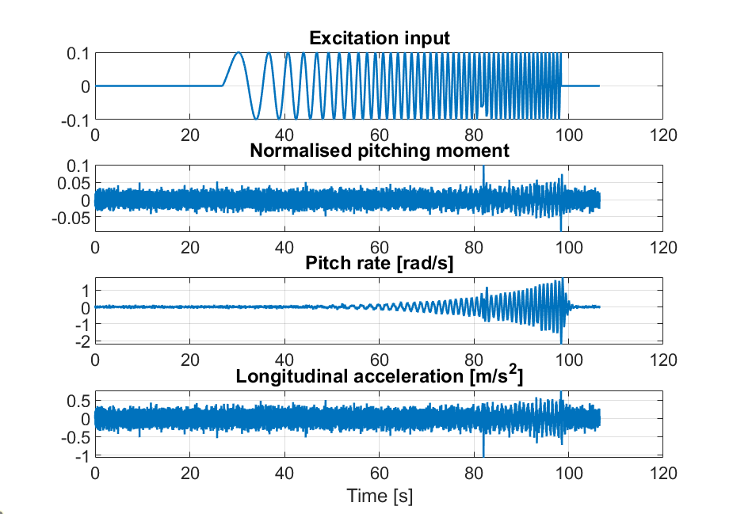
Task 1 – I/O signals
Excitation input :
ExcitationM.mat file - long duration sweep (excite low-frequency translational dynamics)

Slide 5
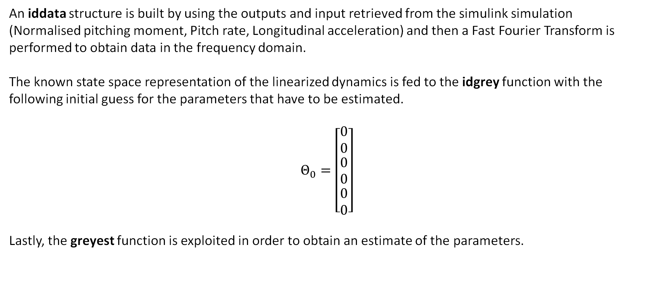
Task 1 – Implementation of the solution
An iddata structure is built by using the outputs and input retrieved from the simulink simulation (Normalised pitching moment, Pitch rate, Longitudinal acceleration) and then a Fast Fourier Transform is performed to obtain data in the frequency domain.
The known state space representation of the linearized dynamics is fed to the idgrey function with the following initial guess for the parameters that have to be estimated.
$$Θ_{0}=\left[\begin{matrix}0 \\ 0 \\ \begin{matrix}0 \\ 0 \\ \begin{matrix}0 \\ 0\end{matrix}\end{matrix}\end{matrix}\right]$$
Lastly, the greyest function is exploited in order to obtain an estimate of the parameters.

Slide 6
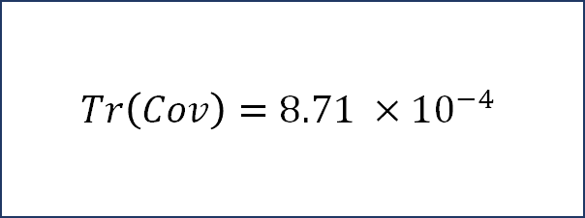
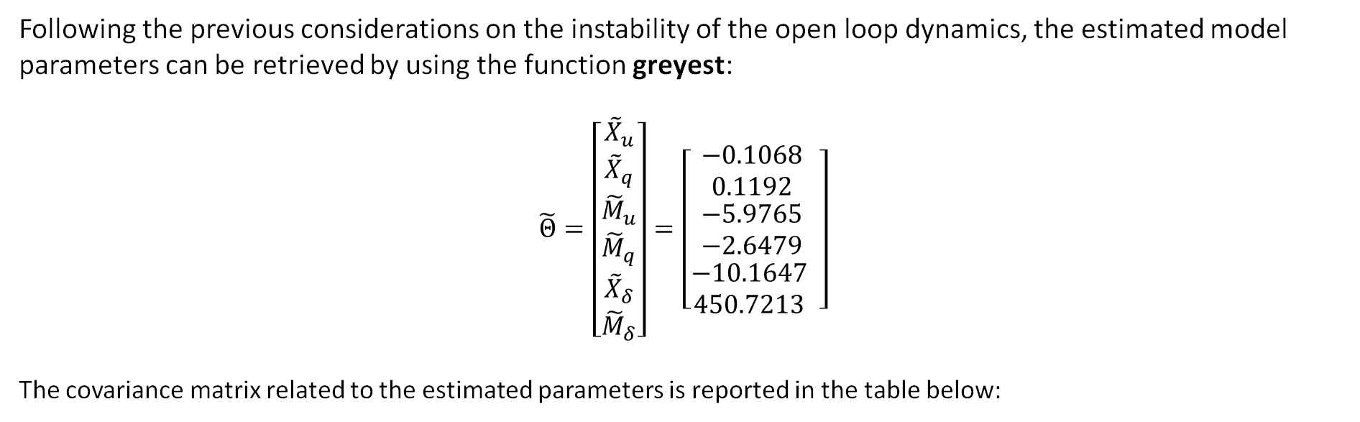
Task 1 – Grey-box model
Following the previous considerations on the instability of the open loop dynamics, the estimated model parameters can be retrieved by using the function greyest:
$$\tilde{Θ}=\left[\begin{matrix}{\tilde{X}}_{u} \\ {\tilde{X}}_{q} \\ \begin{matrix}{\tilde{M}}_{u} \\ {\tilde{M}}_{q} \\ \begin{matrix}{\tilde{X}}_{δ} \\ {\tilde{M}}_{δ}\end{matrix}\end{matrix}\end{matrix}\right]=\left[\begin{matrix}\text{−0.1068 } \\ \text{0.1192 } \\ \begin{matrix}\text{−5.9765 } \\ \text{−2.6479 } \\ \begin{matrix}\text{−10.1647 } \\ \text{450.7213 }\end{matrix} \end{matrix}\end{matrix}\right]$$
The covariance matrix related to the estimated parameters is reported in the table below:
$$Tr\left(Cov\right)=8.71 ×{10}^{−4}$$

Slide 7
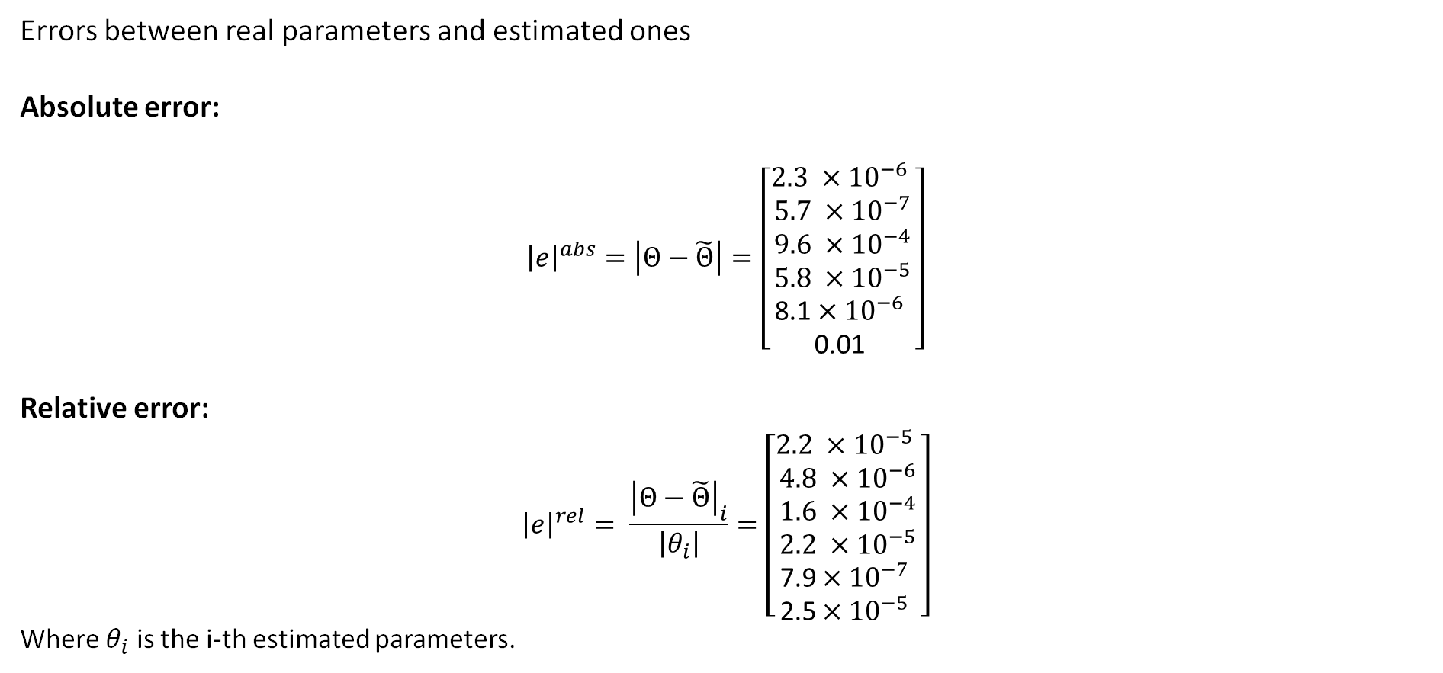
Task 1 – Estimation errors
Errors between real parameters and estimated ones
Absolute error:
$${\left|e\right|}^{abs}=\left|Θ−\tilde{Θ}\right|=\left[\begin{matrix}\text{2}.3 {×10}^{−6} \\ 5.7 ×{10}^{−7} \\ \begin{matrix}9.6 ×{10}^{−4} \\ 5.8 ×{10}^{−5} \\ \begin{matrix}\text{8.1}×{10}^{−6} \\ \text{0.01}\end{matrix} \end{matrix}\end{matrix}\right]$$
Relative error:
$${\left|e\right|}^{rel}= \frac{{\left|Θ−\tilde{Θ}\right|}_{i}}{\left|θ_{i}\right|}=\left[\begin{matrix}\text{2}.2 {×10}^{−5} \\ 4.8 ×{10}^{−6} \\ \begin{matrix}1.6 ×{10}^{−4} \\ 2.2 ×{10}^{−5} \\ \begin{matrix}\text{7.9}×{10}^{−7} \\ \text{2.5}×{10}^{−5}\end{matrix} \end{matrix}\end{matrix}\right]$$
Where $θ_{i}$ is the i-th estimated parameters.

Slide 8
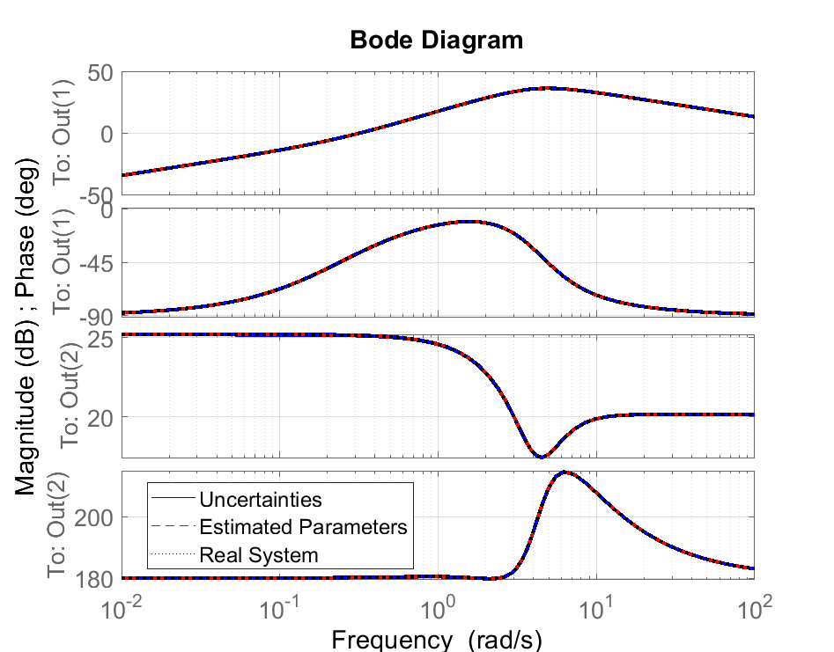
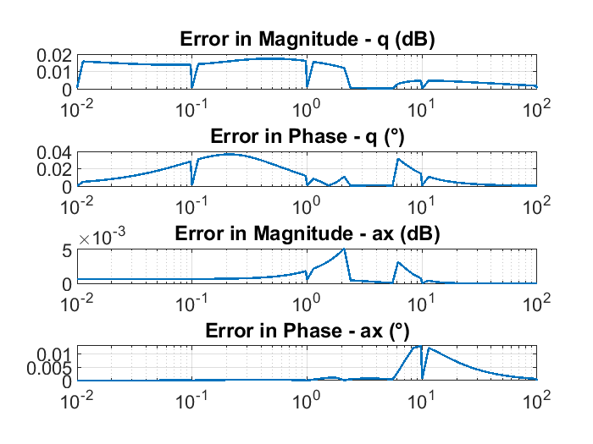
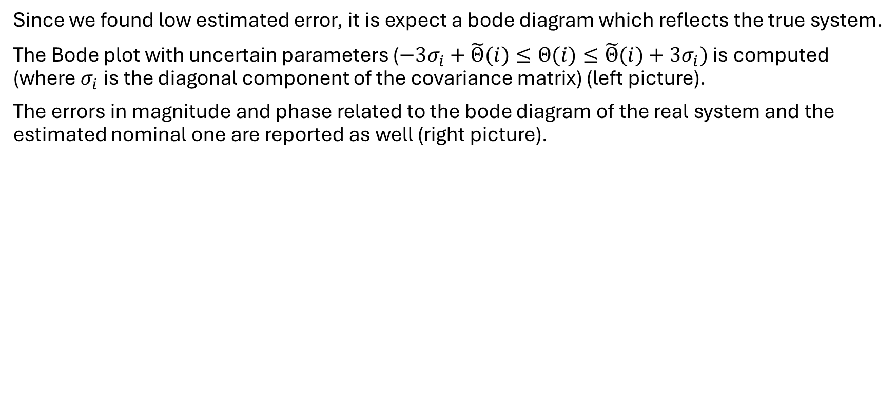
Task 1- Bode Diagrams
Since we found low estimated error, it is expect a bode diagram which reflects the true system.
The Bode plot with uncertain parameters ($−3σ_{i}+\tilde{Θ}(i)≤Θ(i)≤\tilde{Θ}(i)+3σ_{i})$ is computed (where $σ_{i}$ is the diagonal component of the covariance matrix) (left picture).
The errors in magnitude and phase related to the bode diagram of the real system and the estimated nominal one are reported as well (right picture).

Slide 9
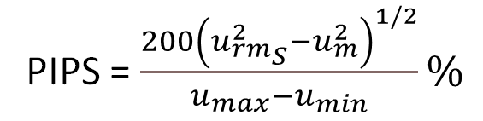
Task 1 - PIPS
PIPS = Performance Index for Perturbation Signals
PIPS is exploited to rate an excitation signal before the experiment to achieve better results in terms of estimates.
PIPS = $\frac{200{\left(u_{rm_{S}}^{2}−u_{m}^{2}\right)}^{1/2}}{u_{max}−u_{min}}\%$
PIPS_{EXCITATION.M}= 57.59%

Slide 10
Task 2 - Introduction
Two different signals will be considered: Sine Sweep and Random Binary Sequence. The following slides report the procedures and the results.
The performance metric for the model quality will be the trace of the covariance matrix. The objective will be the minimization of this parameter.
The PIPS will be another reference parameter.

Slide 11
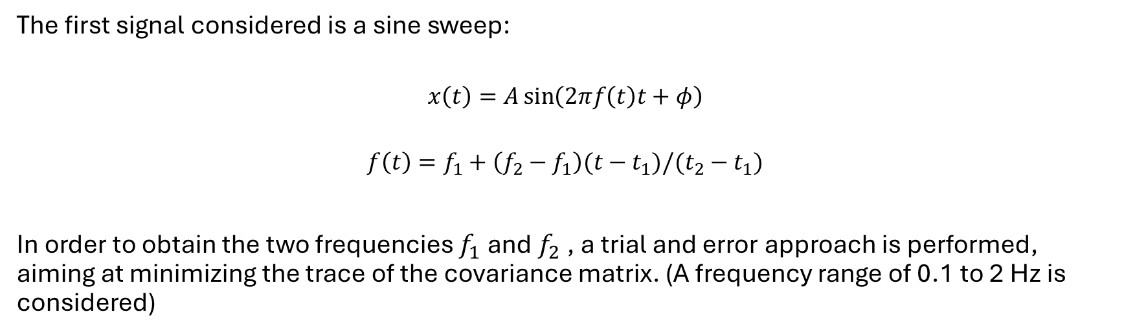
Task 2 – Inputs: Sine sweep
The first signal considered is a sine sweep:
$$x\left(t\right)=A\sin\left(2πf\left(t\right)t+φ\right)$$
$$f\left(t\right)=f_{1}+\left(f_{2}−f_{1}\right)(t−t_{1})/(t_{2}−t_{1})$$
In order to obtain the two frequencies $f_{1}$ and $f_{2}$ , a trial and error approach is performed, aiming at minimizing the trace of the covariance matrix. (A frequency range of 0.1 to 2 Hz is considered)

Slide 12
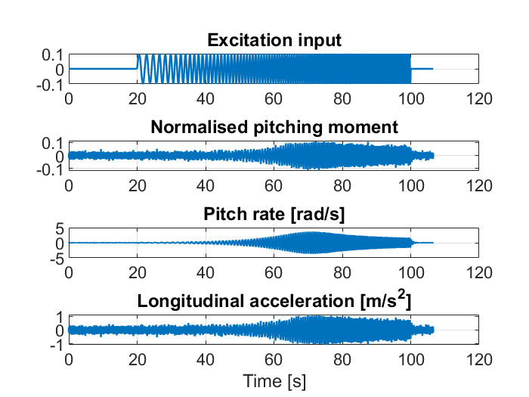
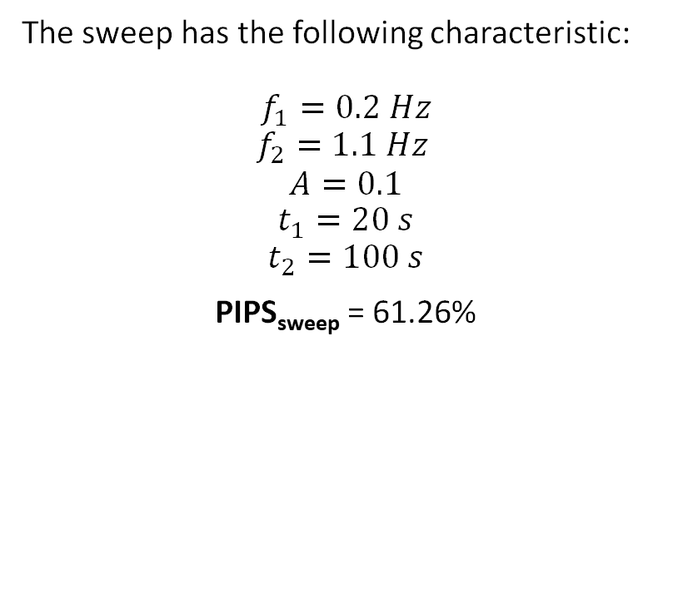
Task 2 – I/O signals
Excitation input :
Sine Sweep - long duration sweep (excite low-frequency translational dynamics).
The overall duration of the experiment is the same as in the task 1, this is due to the Fast Fourier Transform function implemented in Matlab.
The sweep has the following characteristic:
$$f_{1}=0.2 Hz$$
$$f_{2}=1.1 Hz$$
$$A=0.1$$
$$t_{1}=20 s$$
$$t_{2}=100 s$$
PIPS_{sweep} = 61.26%

Slide 13
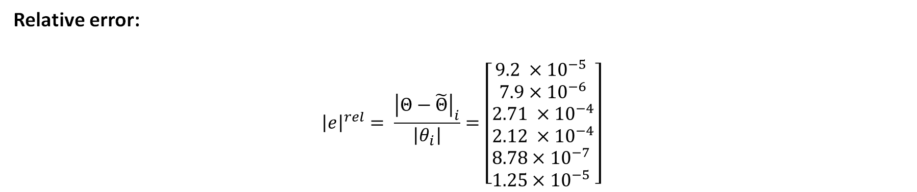

Task 2- Results
Covariance Trace$=5.38 {×10}^{−5}$
Absolute error:
$${\left|e\right|}^{abs}=\left|Θ−\tilde{Θ}\right|=\left[\begin{matrix}9.89 {×10}^{−6} \\ 9.47×{10}^{−7} \\ \begin{matrix}1.6 ×{10}^{−3} \\ 5.63 ×{10}^{−4} \\ \begin{matrix}\text{8.92}×{10}^{−6} \\ \text{5.6}×{10}^{−3}\end{matrix} \end{matrix}\end{matrix}\right]$$
Relative error:
$${\left|e\right|}^{rel}= \frac{{\left|Θ−\tilde{Θ}\right|}_{i}}{\left|θ_{i}\right|}=\left[\begin{matrix}9.2 {×10}^{−5} \\ 7.9×{10}^{−6} \\ \begin{matrix}2.71 ×{10}^{−4} \\ 2.12 ×{10}^{−4} \\ \begin{matrix}8.78×{10}^{−7} \\ \text{1.25}×{10}^{−5}\end{matrix} \end{matrix}\end{matrix}\right]$$

Slide 14
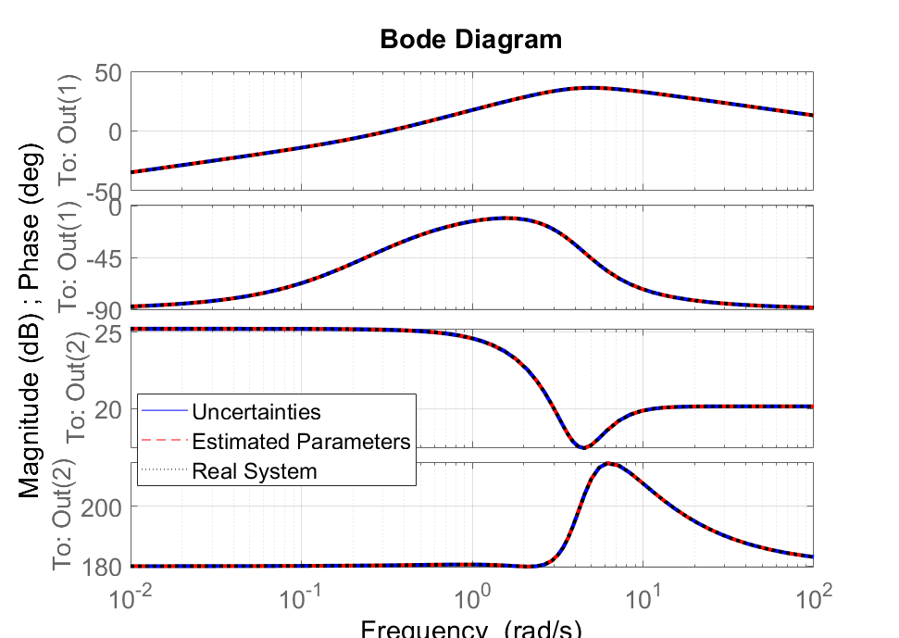
Task 2 –Results
The Bode plot with uncertain parameters ($−3σ_{i}+\tilde{Θ}(i)≤Θ(i)≤\tilde{Θ}(i)+3σ_{i})$ is computed (where $σ_{i}$ is the diagonal component of the covariance matrix).

Slide 15
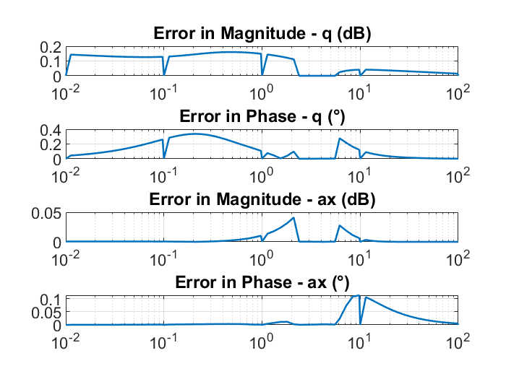
Task 2 –Results
In order to better understand the goodness of the estimated system, the errors in magnitude and phase related to the bode of the real system and the estimated nominal one are reported.

Slide 16
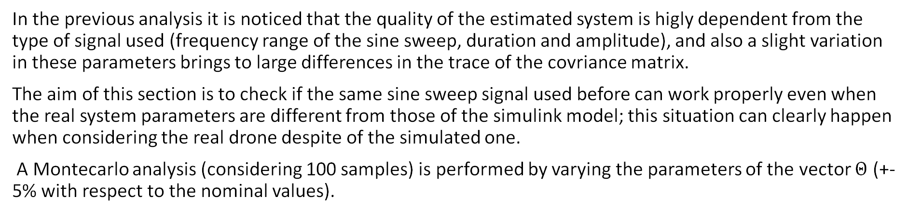
Task 2: Montecarlo Simulation
In the previous analysis it is noticed that the quality of the estimated system is higly dependent from the type of signal used (frequency range of the sine sweep, duration and amplitude), and also a slight variation in these parameters brings to large differences in the trace of the covriance matrix.
The aim of this section is to check if the same sine sweep signal used before can work properly even when the real system parameters are different from those of the simulink model; this situation can clearly happen when considering the real drone despite of the simulated one.
A Montecarlo analysis (considering 100 samples) is performed by varying the parameters of the vector $Θ$ (+- 5% with respect to the nominal values).

Slide 17
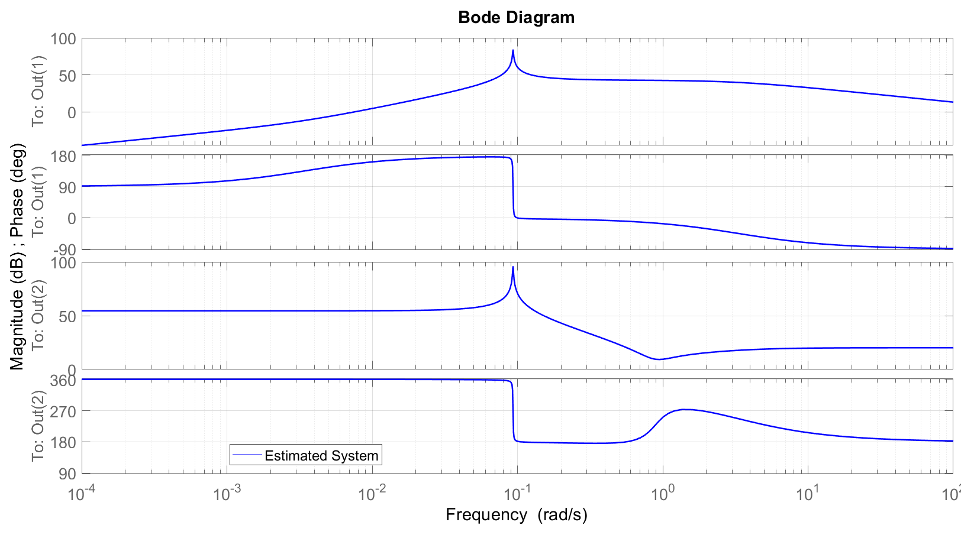
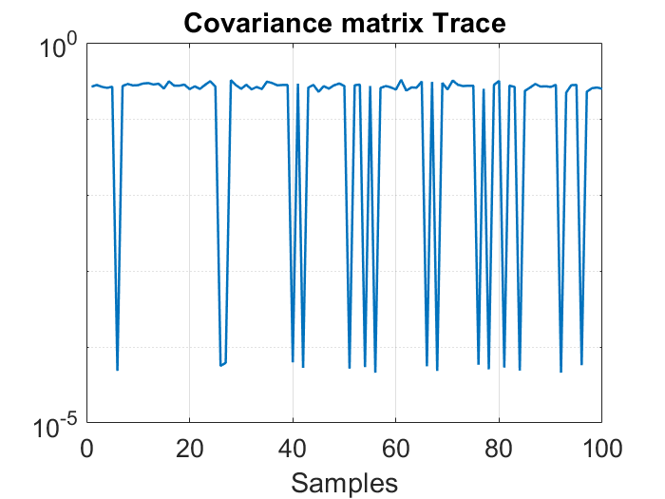
Task 2: Sweep conclusion
Mean of the covariance matrices traces : 0.23
Variance of the covariance matrices traces : 0.010
The results show that the signal can’t estimate properly the system when also the uncertainties on the parameter are taken into account, hence, one solution to this problem could be to repeat the experiment with different types of signals by trial and error.

Slide 18
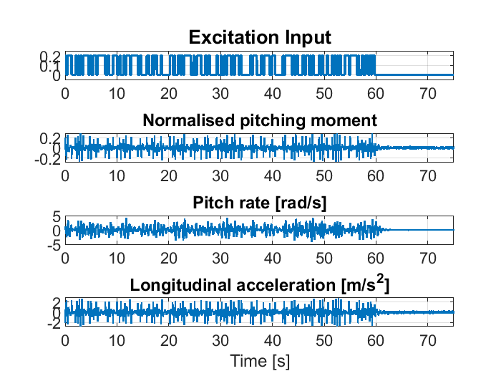
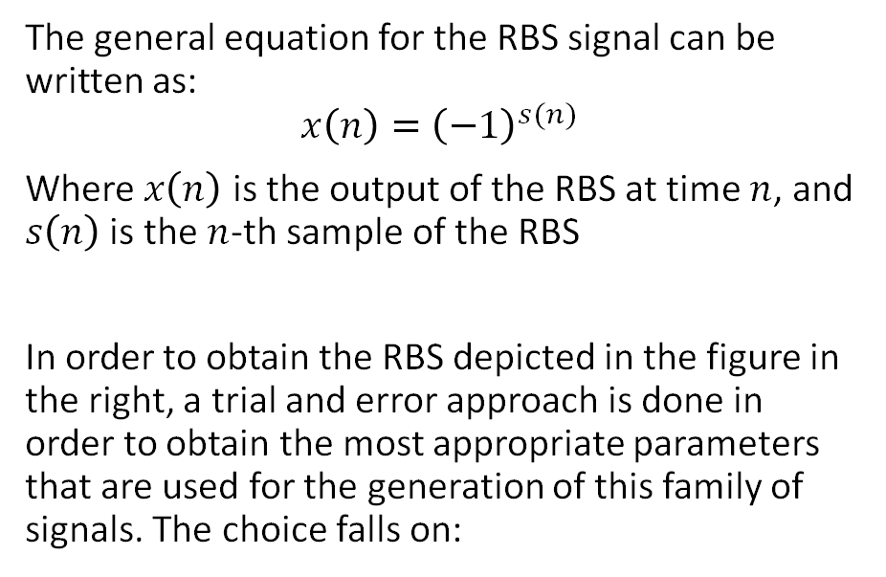

Task 2 – RBS
The general equation for the RBS signal can be written as:
$$x\left(n\right)={\left(−1\right)}^{s(n)}$$
Where $x\left(n\right)$ is the output of the RBS at time $n$, and $s\left(n\right)$ is the $n$-th sample of the RBS
In order to obtain the RBS depicted in the figure in the right, a trial and error approach is done in order to obtain the most appropriate parameters that are used for the generation of this family of signals. The choice falls on:
$$t_{0}=0 s$$
$$A=0.2$$
$$∆t=0.25 s$$
$$T=60 s$$
PIPS_{RBS} = 97.83%

Slide 19
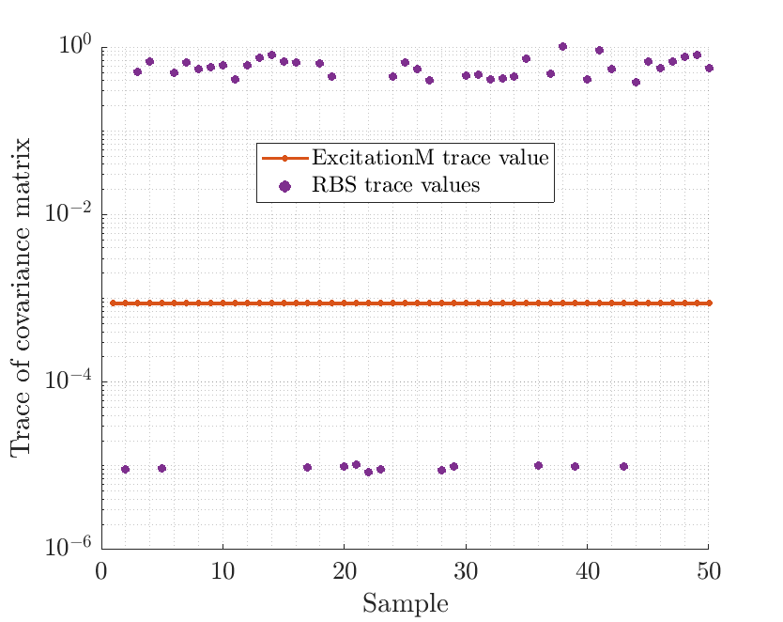
Task 2 –RBS generation
Then 50 sequences are generated and given as input to the system by using the simulator implented in simulink. By extracting the simulated outputs and following the same steps performed in the first task, the estimated parameters and their uncertainties are obtained and then compared to the ones obtained by using as input the function contained in the file ExcitationM.
Only the 12 sequences that decrease the trace of the covariance matrix are taken into account for the next step.

Slide 20
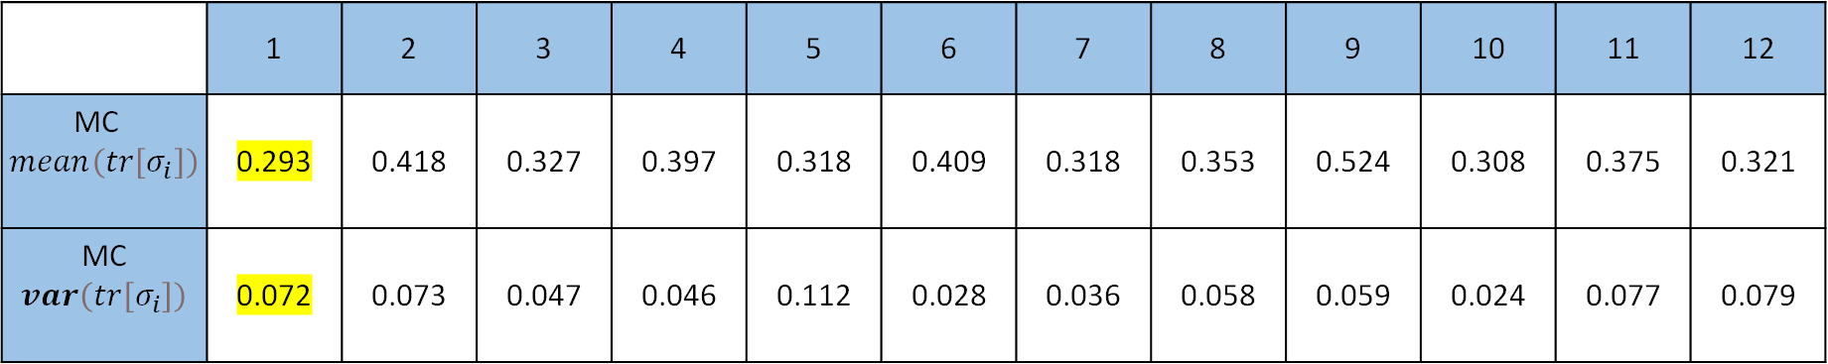
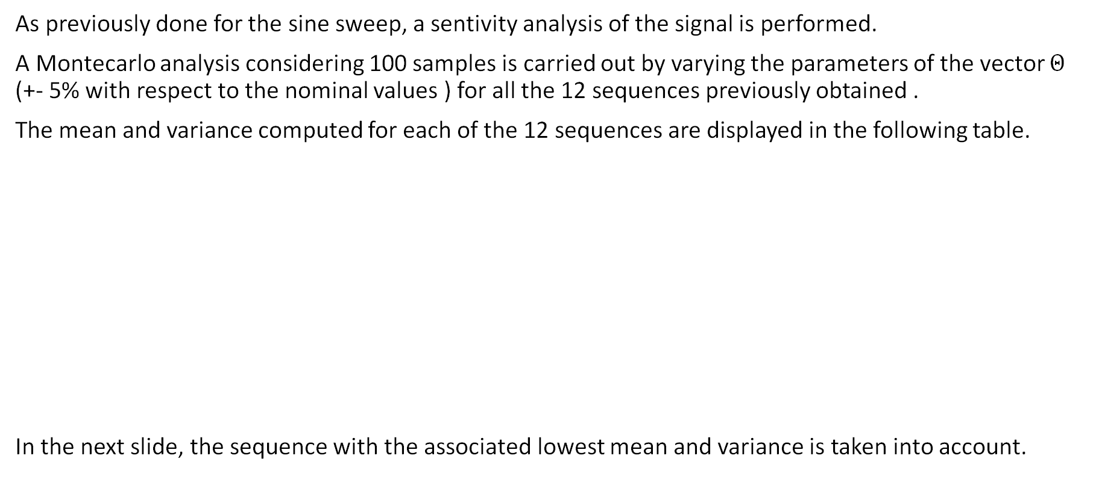
Task 2 – RBS: sensitivity
As previously done for the sine sweep, a sentivity analysis of the signal is performed.
A Montecarlo analysis considering 100 samples is carried out by varying the parameters of the vector $Θ$ (+- 5% with respect to the nominal values ) for all the 12 sequences previously obtained .
The mean and variance computed for each of the 12 sequences are displayed in the following table.
In the next slide, the sequence with the associated lowest mean and variance is taken into account.
 | 1 | 2 | 3 | 4 | 5 | 6 | 7 | 8 | 9 | 10 | 11 | 12
MC $mean\left(tr\left[σ_{i}\right]\right)$ | 0.293 | 0.418 | 0.327 | 0.397 | 0.318 | 0.409 | 0.318 | 0.353 | 0.524 | 0.308 | 0.375 | 0.321
MC $var\left(tr\left[σ_{i}\right]\right)$ | 0.072 | 0.073 | 0.047 | 0.046 | 0.112 | 0.028 | 0.036 | 0.058 | 0.059 | 0.024 | 0.077 | 0.079

Slide 21
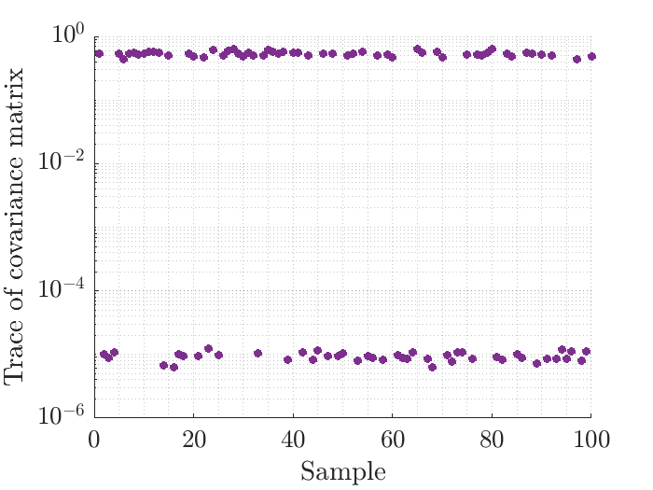
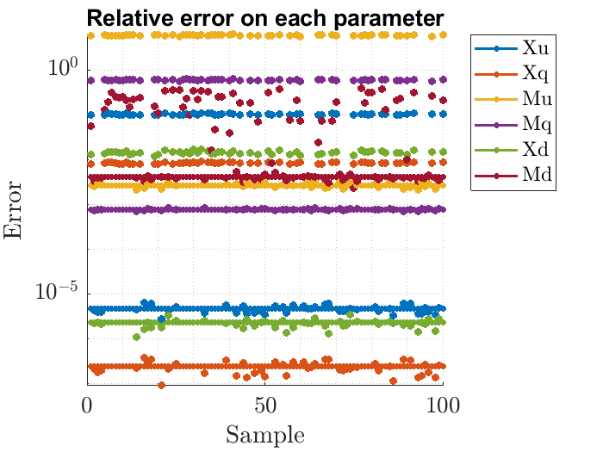
Task 2 – RBS: sensitivity
In the following images are reported the traces of the covariance matrices (right picture) and the relative error between the estimated parameters and the real ones (left picture).

Slide 22
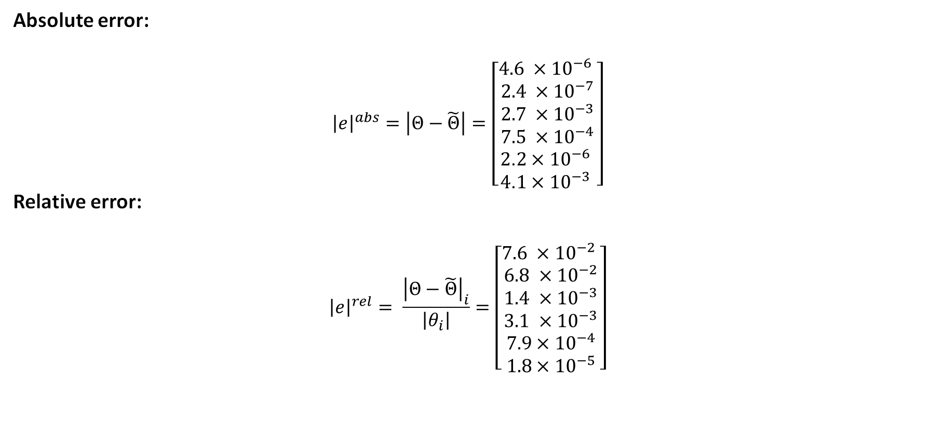

Task 2 RBS: Results
Analyzing the best RBS in the nominal case (not considering uncertainties on the real parameters), the following results are obtained:
Absolute error:
$${\left|e\right|}^{abs}=\left|Θ−\tilde{Θ}\right|=\left[\begin{matrix}4.6 {×10}^{−6} \\ 2.4 ×{10}^{−7} \\ \begin{matrix}2.7 ×{10}^{−3} \\ 7.5 ×{10}^{−4} \\ \begin{matrix}\text{2}\text{.}2×{10}^{−6} \\ \text{4}\text{.}1×{10}^{−3}\end{matrix} \end{matrix}\end{matrix}\right]$$
Relative error:
$${\left|e\right|}^{rel}= \frac{{\left|Θ−\tilde{Θ}\right|}_{i}}{\left|θ_{i}\right|}=\left[\begin{matrix}7.6 {×10}^{−2} \\ 6.8 ×{10}^{−2} \\ \begin{matrix}1.4 ×{10}^{−3} \\ 3.1 ×{10}^{−3} \\ \begin{matrix}7.9×{10}^{−4} \\ 1.8×{10}^{−5}\end{matrix}\end{matrix}\end{matrix}\right]$$
Covariance Trace $=8.99 ×{10}^{−6}$

Slide 23
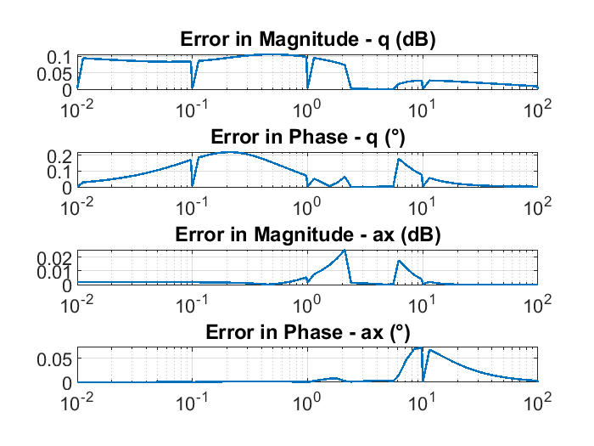
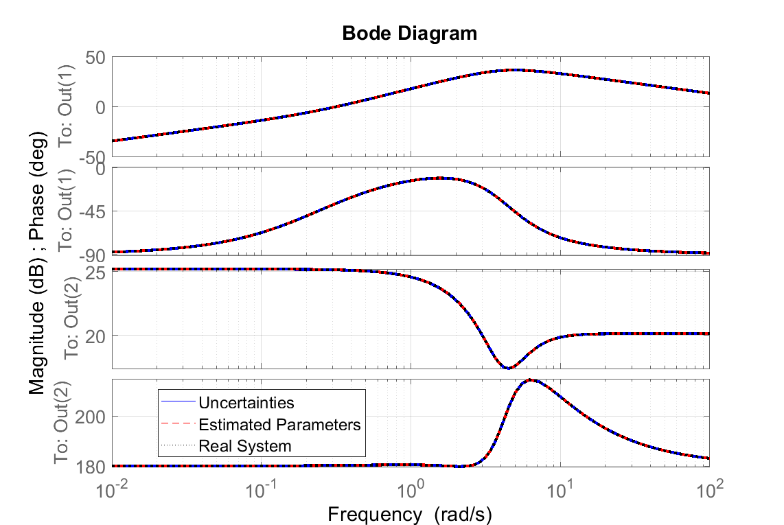
Task 2 –RBS conclusions
Following the same steps as in the sine sweep section, the following results are retrieved.

Slide 24
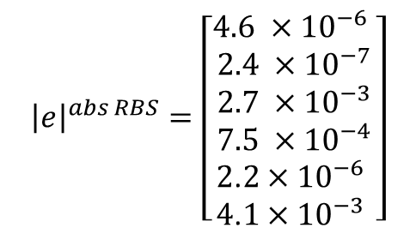
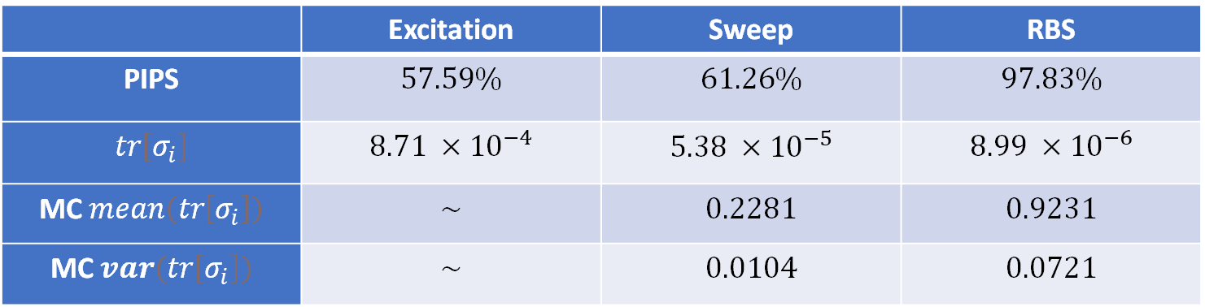

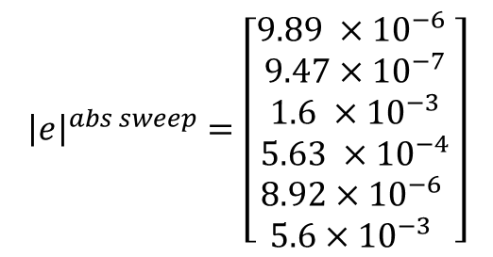
Task 2 - Final results
A sum up of results is presented here:
 | Excitation | Sweep | RBS
PIPS | $$57.59\%$$ | $$61.26\%$$ | $$97.83\%$$
$$tr\left[σ_{i}\right]$$ | $$8.71 ×{10}^{−4}$$ | $$5.38 ×{10}^{−5}$$ | $$8.99 ×{10}^{−6}$$
MC $mean\left(tr\left[σ_{i}\right]\right)$ | $$\sim$$ | $$0.2281$$ | $$0.9231$$
MC $var\left(tr\left[σ_{i}\right]\right)$ | $$\sim$$ | $$0.0104$$ | $$0.0721$$
Absolute Error:
$${\left|e\right|}^{abs RBS}=\left[\begin{matrix}4.6 {×10}^{−6} \\ 2.4 ×{10}^{−7} \\ \begin{matrix}2.7 ×{10}^{−3} \\ 7.5 ×{10}^{−4} \\ \begin{matrix}\text{2}\text{.}2×{10}^{−6} \\ \text{4}\text{.}1×{10}^{−3}\end{matrix} \end{matrix}\end{matrix}\right]$$
$${\left|e\right|}^{abs Excitation}=\left[\begin{matrix}\text{2}.3 {×10}^{−6} \\ 5.7 ×{10}^{−7} \\ \begin{matrix}9.6 ×{10}^{−4} \\ 5.8 ×{10}^{−5} \\ \begin{matrix}\text{8.1}×{10}^{−6} \\ \text{0.01}\end{matrix} \end{matrix}\end{matrix}\right]$$
$${\left|e\right|}^{abs sweep}=\left[\begin{matrix}9.89 {×10}^{−6} \\ 9.47×{10}^{−7} \\ \begin{matrix}1.6 ×{10}^{−3} \\ 5.63 ×{10}^{−4} \\ \begin{matrix}\text{8.92}×{10}^{−6} \\ \text{5.6}×{10}^{−3}\end{matrix} \end{matrix}\end{matrix}\right]$$

Slide 25
Thank you for the attention

